Slide 1
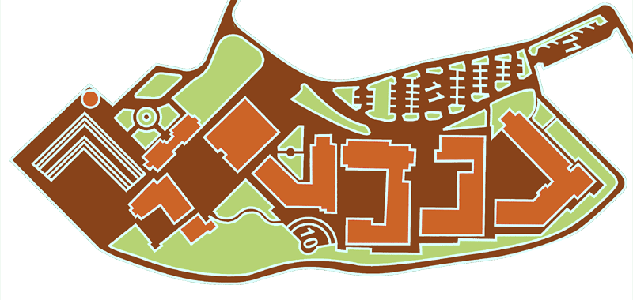
Dormitories
And health center
Sports center
Swimming
pool
10
8
Henry Ford
Building
3
2
7
1
4
5
9
6
University Student Center
Library
Administration
Admistrative Sciences Faculty
Social Sciences Faculty
Science Faculty
7. Engineering Faculty
8. Parking
9. Tower
10. Minibuses to Sarıyer
Food Court
Conference Hall (SCI 103)
Shuttle departs for dinner on monday

